Slide 1








PAML + Workshop – Aug to Dec 2025
ClipCatch AI
Centre for Innovation and Entrepreneurship (CIE)

Slide 2
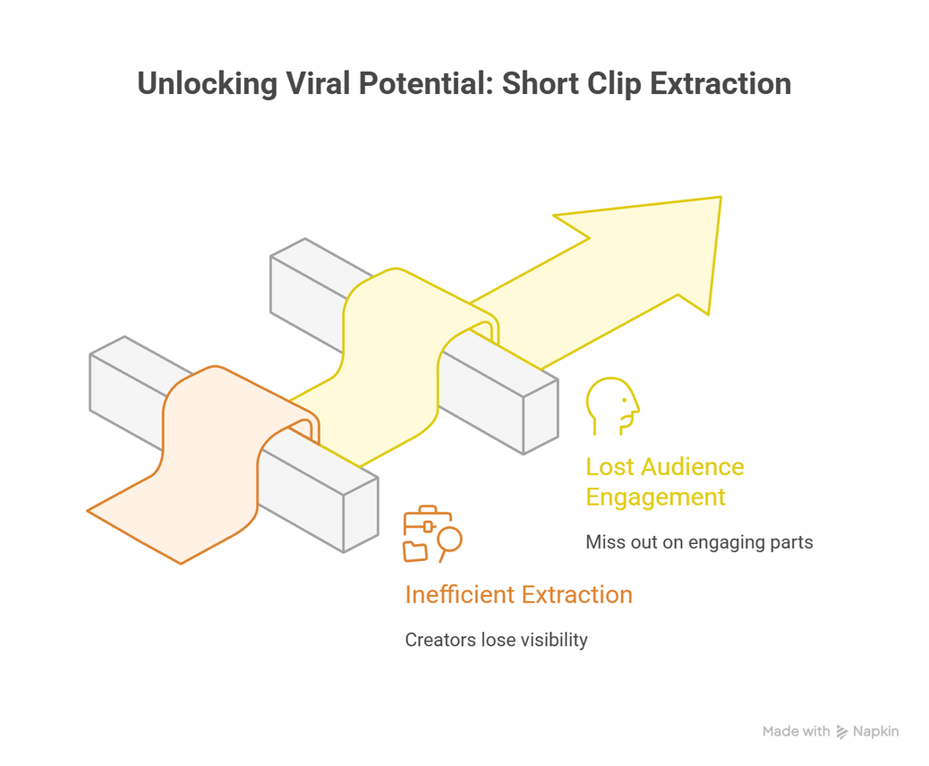
The Problem
Every day, thousands of creators upload long videos, but most of their best moments remain buried. Without an efficient way to extract short viral-ready clips, creators lose visibility and audiences miss out on the most engaging parts.
CIE | PES University
1

Slide 3
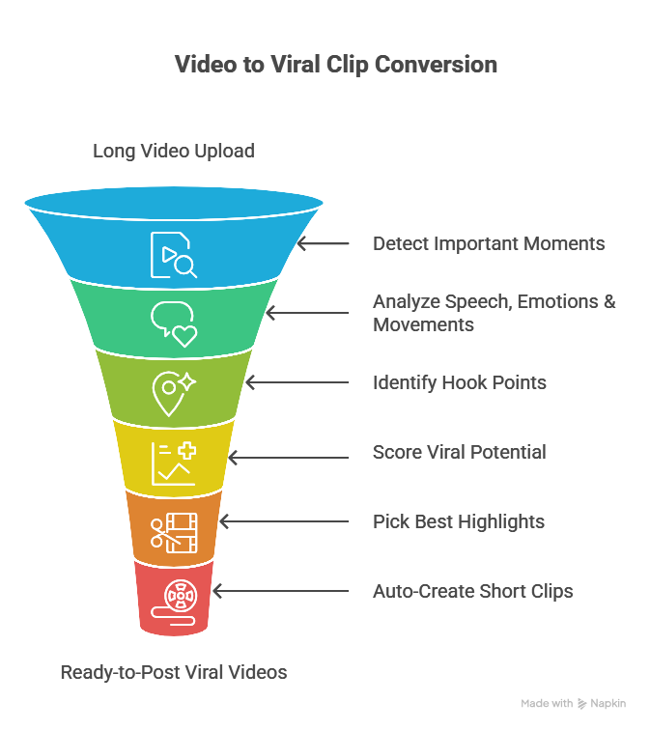
The Solution
What ClipCatch AI bring to the table
CIE | PES University
1

Slide 4
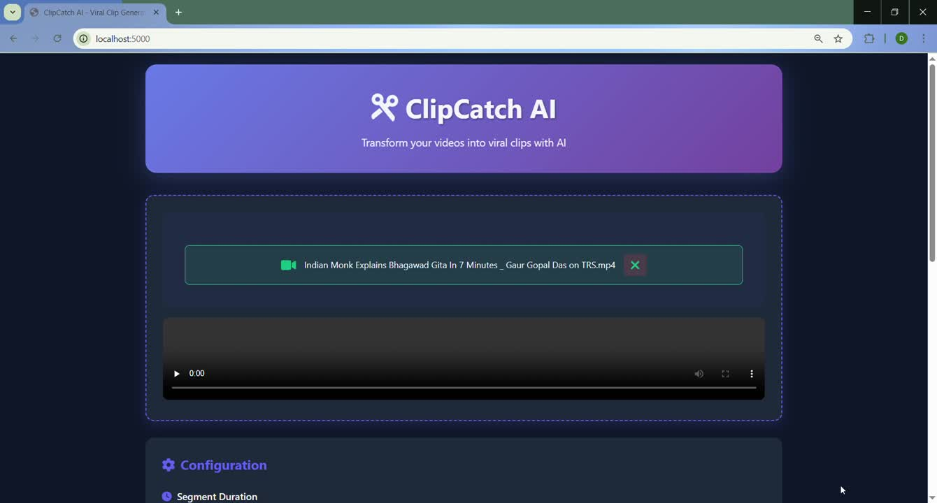
Demo of the app - Podcast
CIE | PES University
1

Slide 5
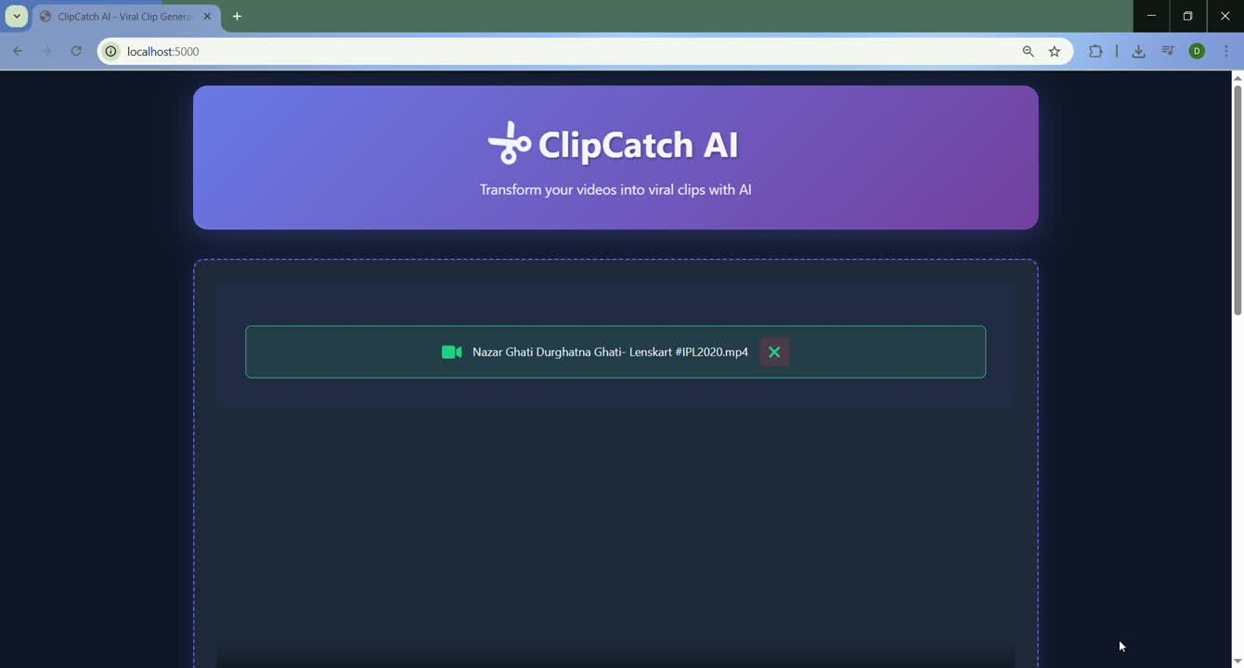
Demo of the app - Sports
CIE | PES University
1

Slide 6
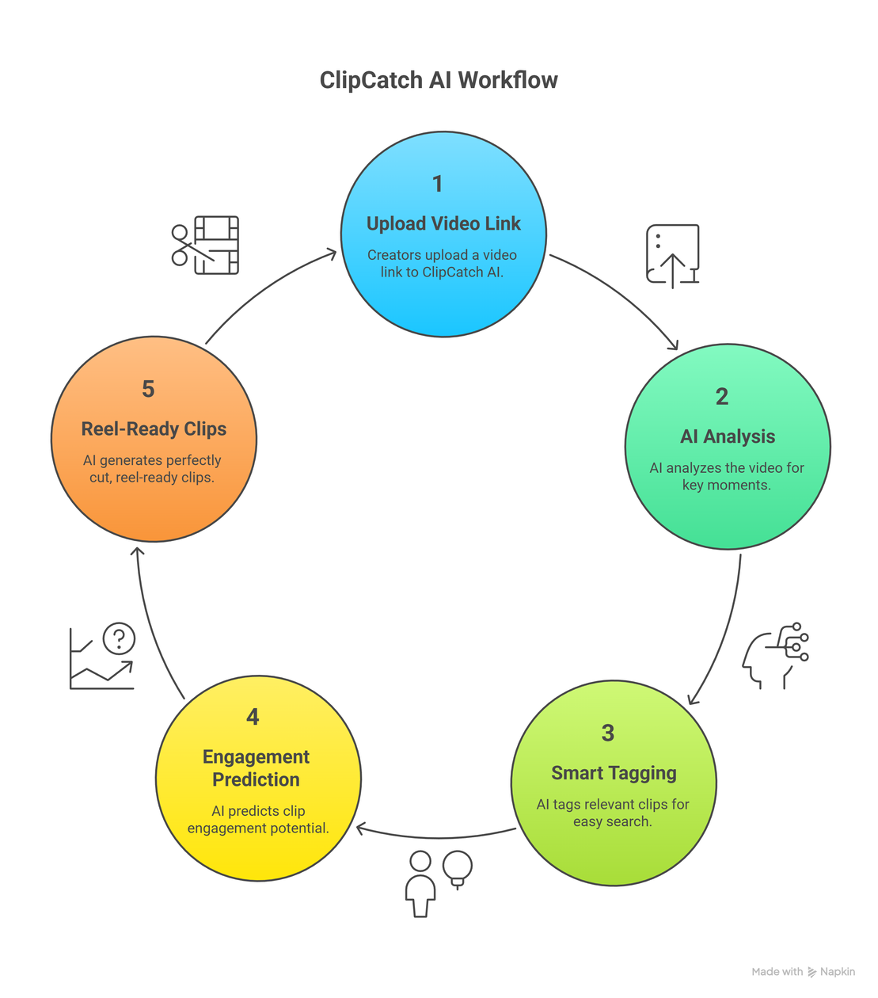
How Does ClipCatch Work?
CIE | PES University
1

Slide 7
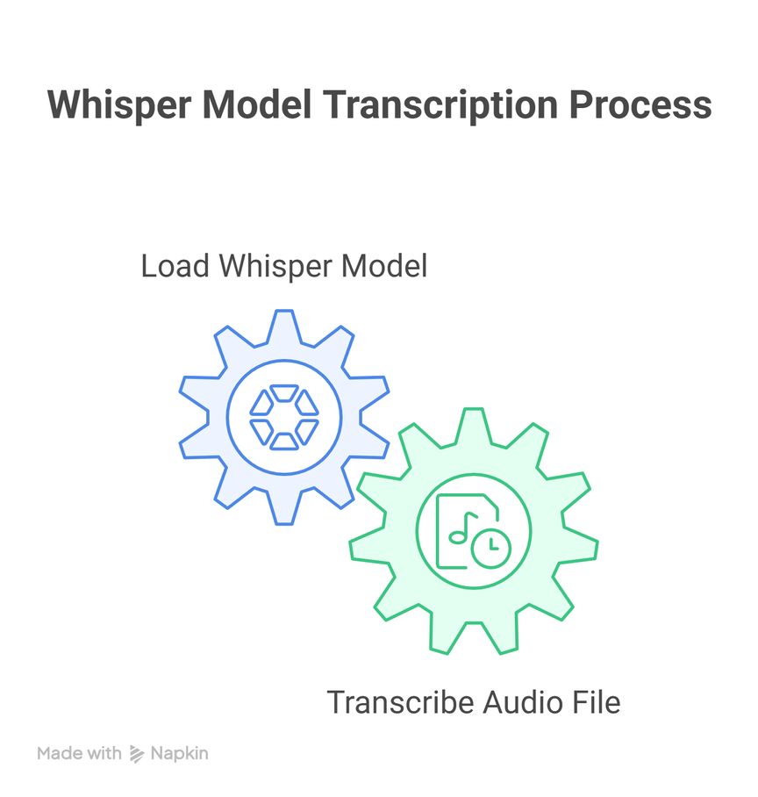
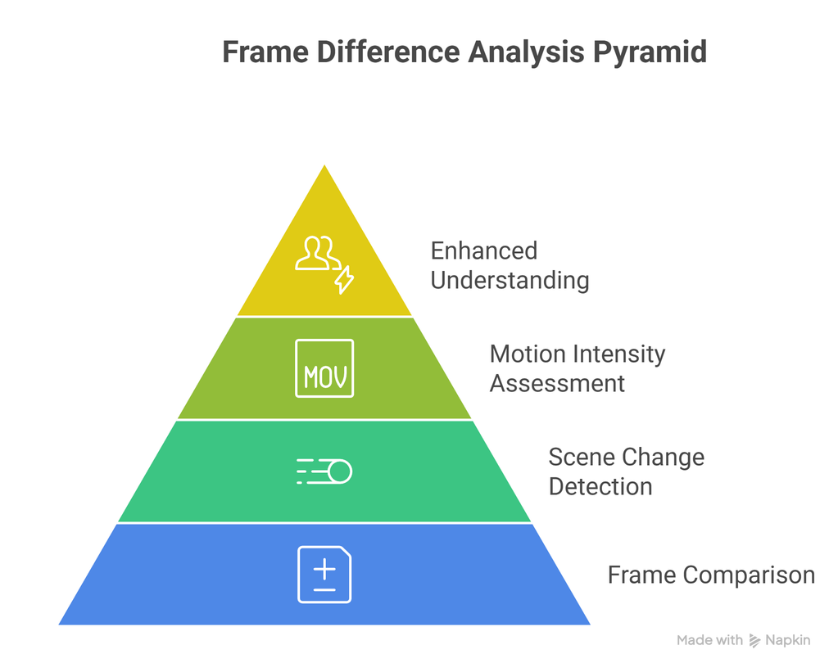
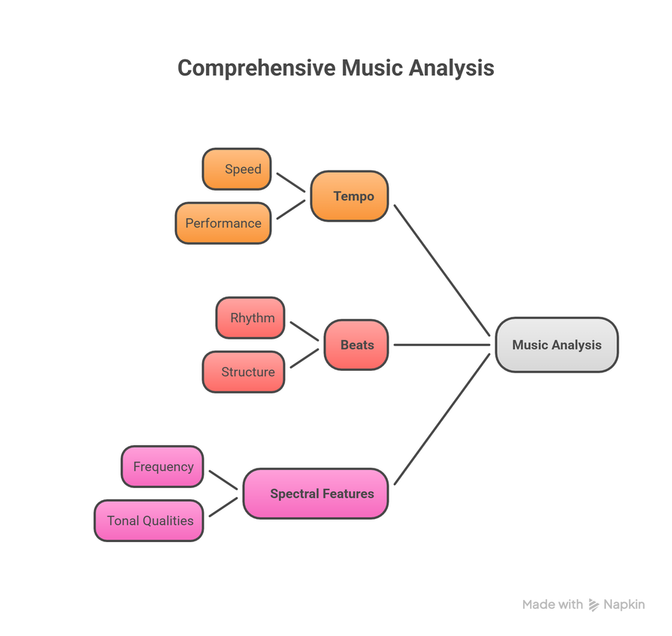
What’s actually going on
CIE | PES University
1

Slide 8
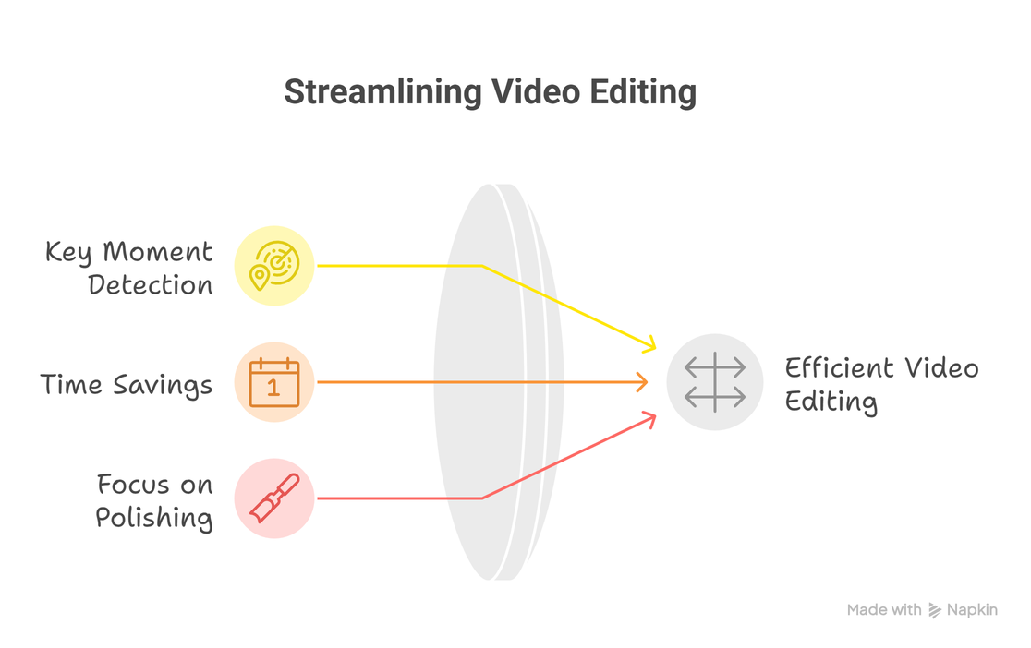
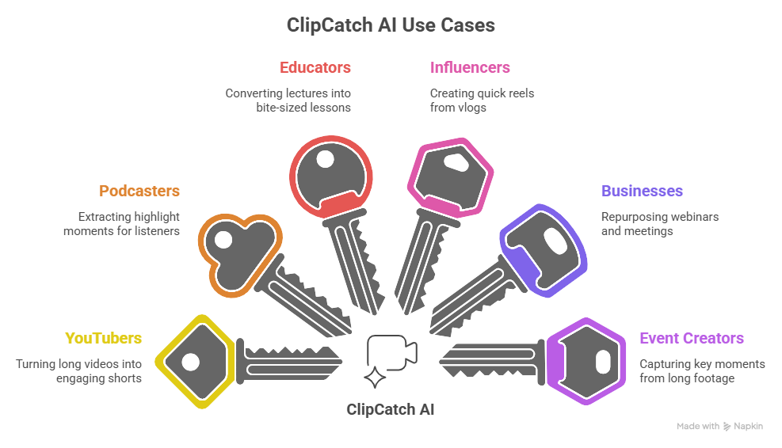
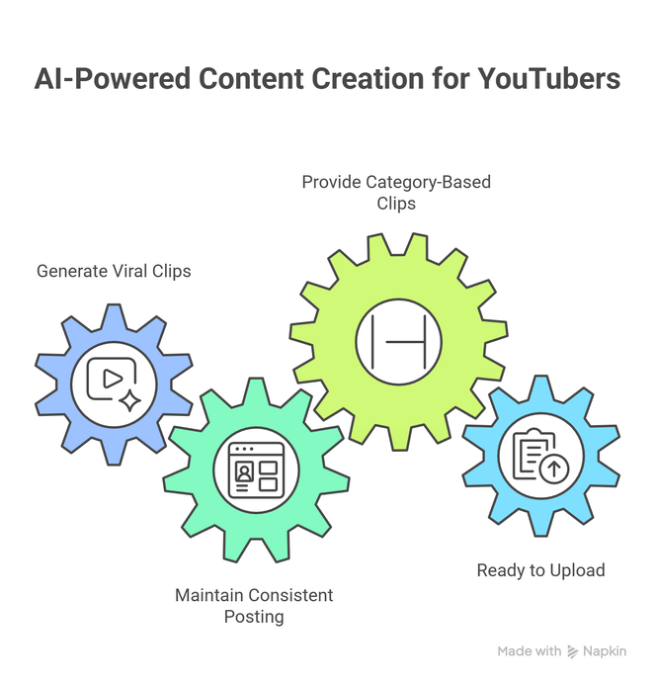
Use-Cases
CIE | PES University
1

Slide 9
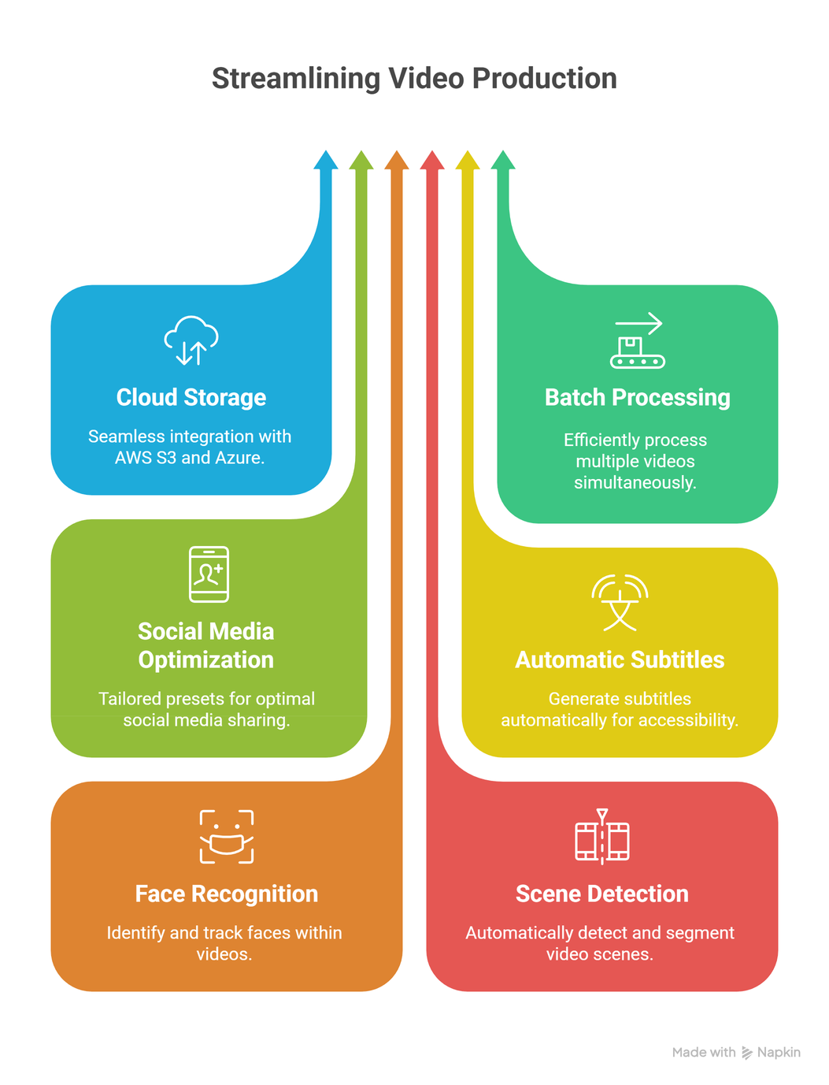
Future-Scope
CIE | PES University
1

Slide 10
THANK YOU!
-Team 5
By- Simret, Ananya, Dhriti Rajesh, Ramith, Skanda, Aadhitya
CIE | PES University
1

